Slide 1

Group - 4
Bank Analytics
MR. Samanasa Shiva baba
MR. Jyotirmaya Anil Sahu
MR. Phaijan gani shaikh
MS. Magatapalli Kadalika
MR. Sushrut P. Ujjainkar
MS. Hande Pooja Dattatray
MR. Rajendra Sahoo

Slide 2
PROJECT AIM
THE PROJECT AIM TO ANALYZE THE FINANCE DATA SET OF BANK LOAN CUSTOMERS,THROUGH REPORT TO GET INSIGHT FROM IT BY
USING DIFFERENT SOFTWARE TOOLS SUCH AS EXCEL,MYSQL,TABLEAU AND POWER BI
FROM THIS INSIGHTS THIR ACCURATE BUSINESS DECISINS ARE MADE

Slide 3
TOOLS USED IN THE PROJECT
EXCEL
MYSQL
POWER BI
TABLEAU

Slide 4

DATA ANALYSIS PROCESS
STEP 1 : DEFINE THE QUESTION
STEP 2 : COLLECT THE DATA
STEP 3 : CLEAN THE DATA
STEP 4 : ANALYZE THE DATA
STEP 5 : VISUALIZE AND SHARE THE INSIGHTS

Slide 5
WHAT IS Bank Analytics
Bank analysis refers to the evaluation of financial institutions such as banks, credit unions, and other similar entities. It involves assessing various aspects of a bank's operations, financial health, performance, risk management, and overall stability. Bank analysis is typically conducted by financial analysts, investors, regulators, and stakeholders to make informed decisions regarding investments, risk management, and regulatory compliance.

Slide 6

Key Performance Indicator(KPI)
Year wise loan amount Stats
Grade and sub grade wise revol_bal
Total Payment for Verified Status Vs Total Payment for Non Verified Status
State wise and last_credit_pull_d wise loan status
Home ownership Vs last payment date stats

Slide 7

Data cleaning is the process of identifying and rectifying errors, inconsistencies, and inaccuracies in a dataset to ensure its quality and reliability for analysis. This involves tasks such as removing duplicate records, correcting spelling mistakes, filling in missing values, and standardizing formats. Data cleaning also includes identifying outliers and anomalies that may skew analysis results and deciding whether to correct, remove, or retain them based on their significance. By performing data cleaning, analysts can enhance the accuracy and integrity of the dataset, leading to more reliable and meaningful insights during analysis.
DATA CLEANING

Slide 8
EXCEL DASHBOARD

Slide 9
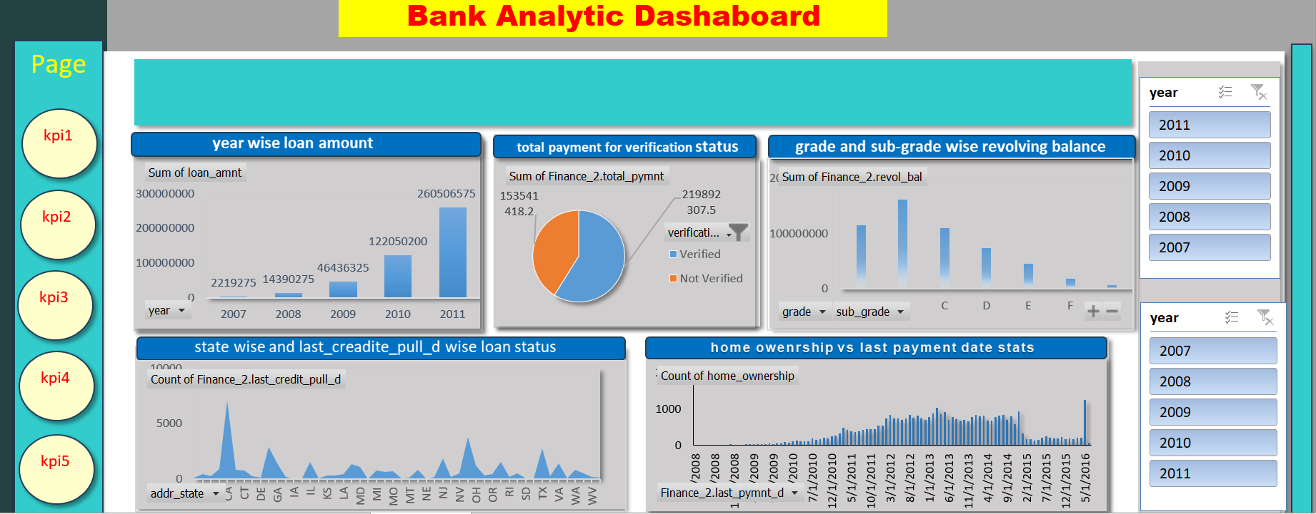

Slide 10
POWERBI DASHBOARD

Slide 11
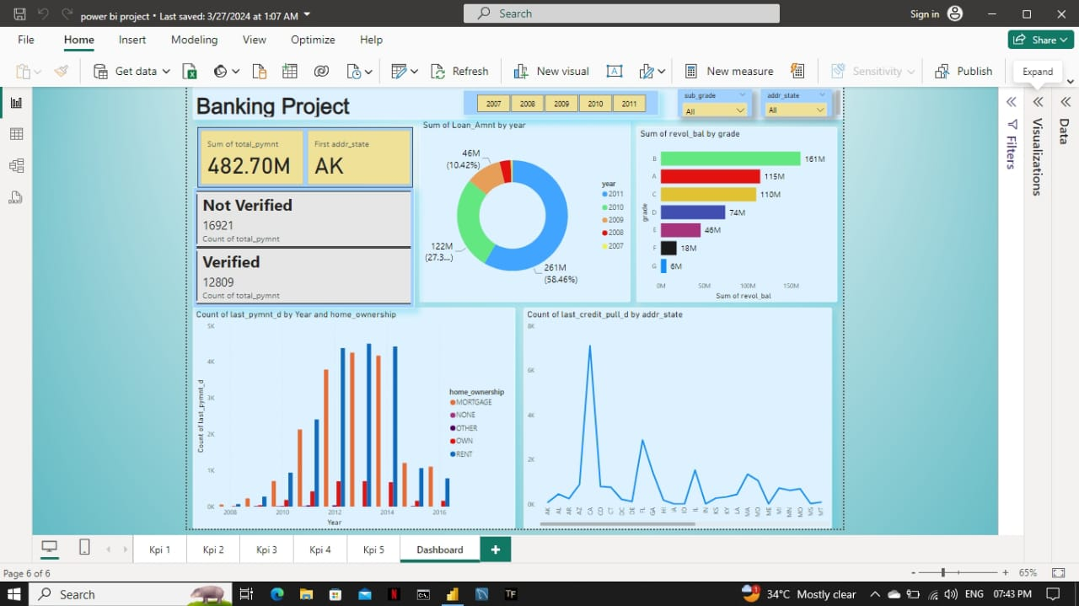

Slide 12
TABLEAU DASHBOARD

Slide 13
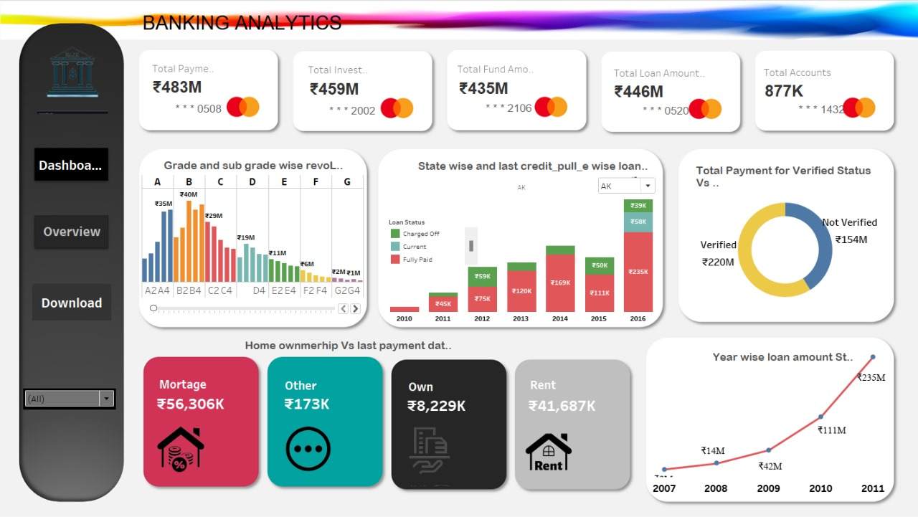

Slide 14
SQL OUTPUT

Slide 15
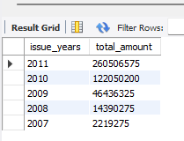
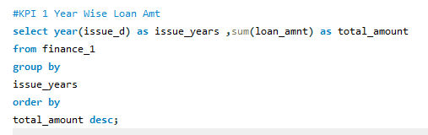
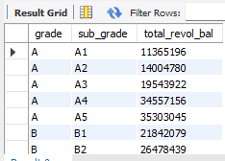
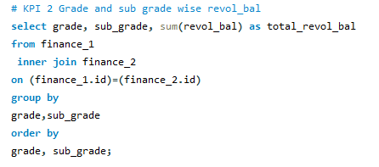

Slide 16
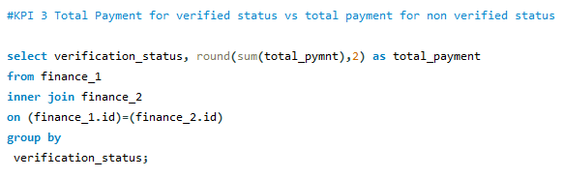
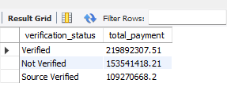
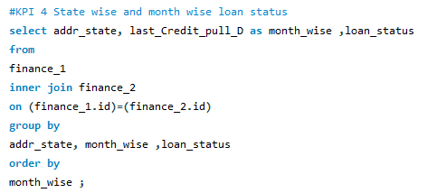
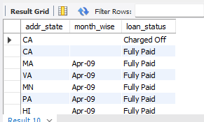

Slide 17
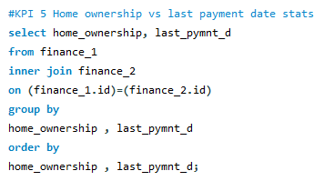
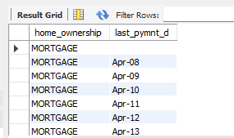

Slide 18

Conclusions
Bank analytics encompass a comprehensive examination of various key metrics essential for understanding the institution's performance and risk management. Through year-wise loan amount statistics, insights into lending trends and patterns emerge, guiding strategic decision-making. Analysis of grade and sub-grade-wise revolving balance offers a nuanced understanding of credit quality and customer behavior. Comparing total payments for verified versus non-verified statuses sheds light on risk exposure and payment reliability. Evaluating loan status by state and last credit pull date provides geographic and temporal insights into portfolio performance. Lastly, exploring the relationship between home ownership and last payment date unveils potential correlations impacting repayment behavior. By leveraging these diverse analytical approaches, banks can optimize lending strategies, mitigate risks, and enhance overall financial health.

Slide 19

THANK YOU

